Slide 1
Digital Logic & Design
Lecture 06

Slide 2
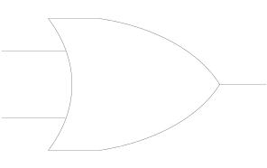
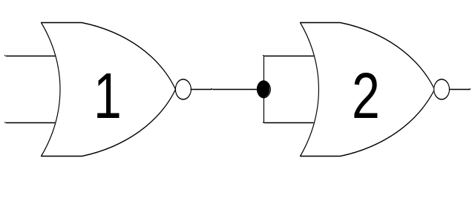
NOR Universal Gate
Input |  | Output
A | B | F
0 | 0 | 0
0 | 1 | 1
1 | 0 | 1
1 | 1 | 1

Slide 3
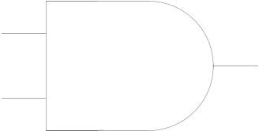
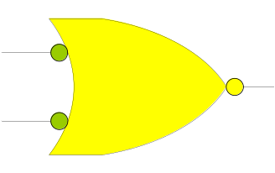
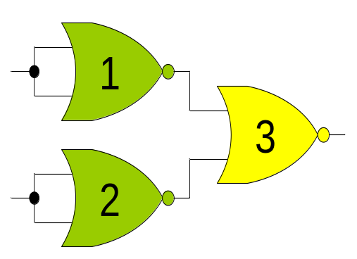
NOR Universal Gate
Input |  | Output
A | B | F
0 | 0 | 0
0 | 1 | 0
1 | 0 | 0
1 | 1 | 1

Slide 4
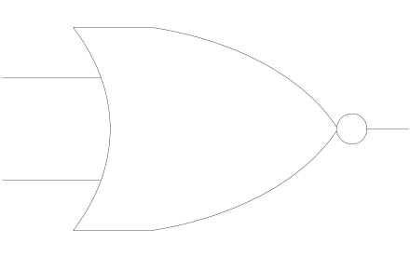
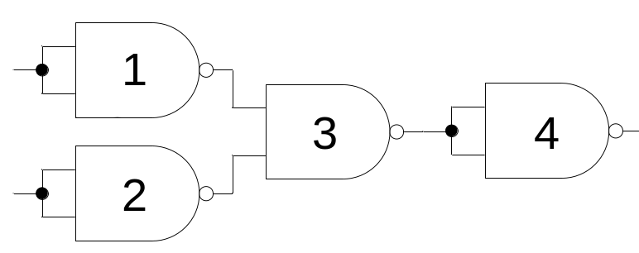
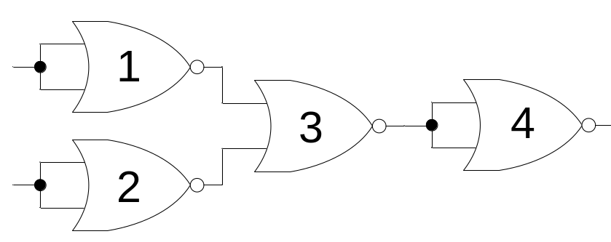
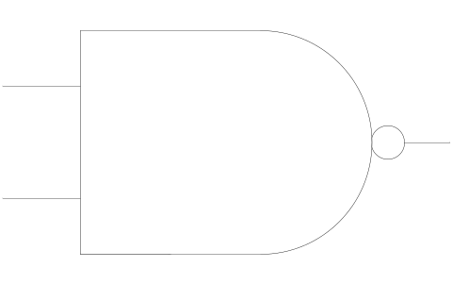
NAND-NOR Universal Gate

Slide 5
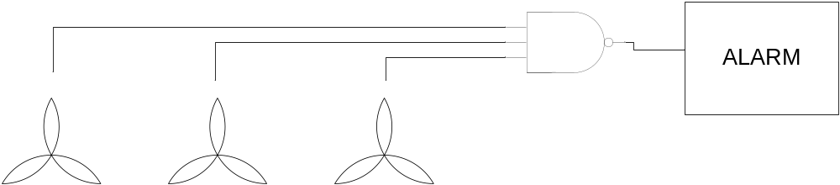
NAND Gate Applications
Device Failure Alarm
Notes:
Toxic fumes produced by the chemicals are removed from the ware house and dispersed in the atmosphere through three exhaust fans.
When all fans are working the input to the NAND gate is 111 and the output is 0
When any one fan fails the output of NAND gate becomes 1 sounding an alarm connected tot the output of the NAND gate.

Slide 6
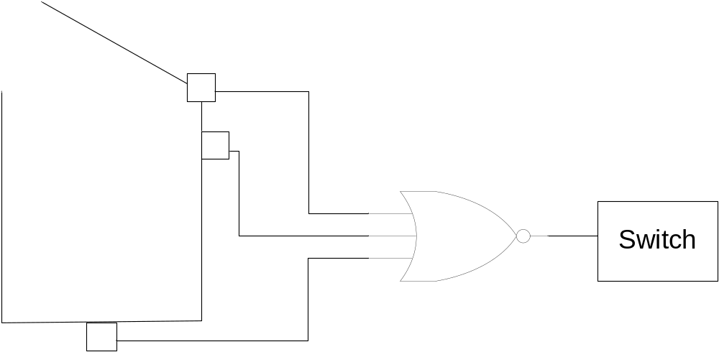
NOR Gate Applications
Washing Machine Controller
Notes:
Three sensors check for washing machine lid open, washing tub filled to minimum level and weight of cloths and water in the tub.
If the lid is open or the water is below the minimum level or the washing machine has been overloaded the appropriate sensor sets its output to 1. The NOR gate output is set to 0 switching off the washing machine.

Slide 7
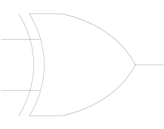
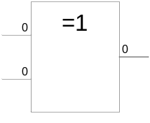
XOR Gate
1 output
2 inputs
Multiple inputs

Slide 8

XOR Gate function
Input |  | Output
A | B | F
0 | 0 | 0
0 | 1 | 1
1 | 0 | 1
1 | 1 | 0

Slide 9
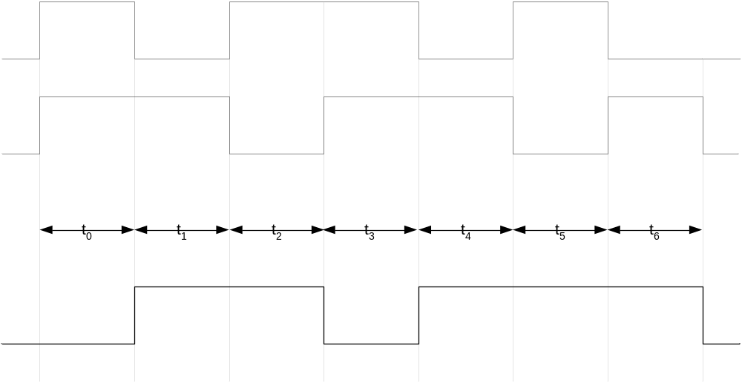
XOR Gate Timing Diagram

Slide 10
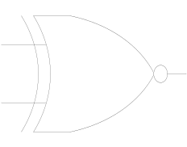
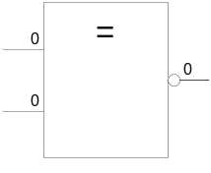
XNOR Gate
1 output
2 inputs
Multiple inputs

Slide 11
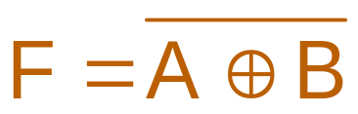
XNOR Gate function
Input |  | Output
A | B | F
0 | 0 | 1
0 | 1 | 0
1 | 0 | 0
1 | 1 | 1

Slide 12
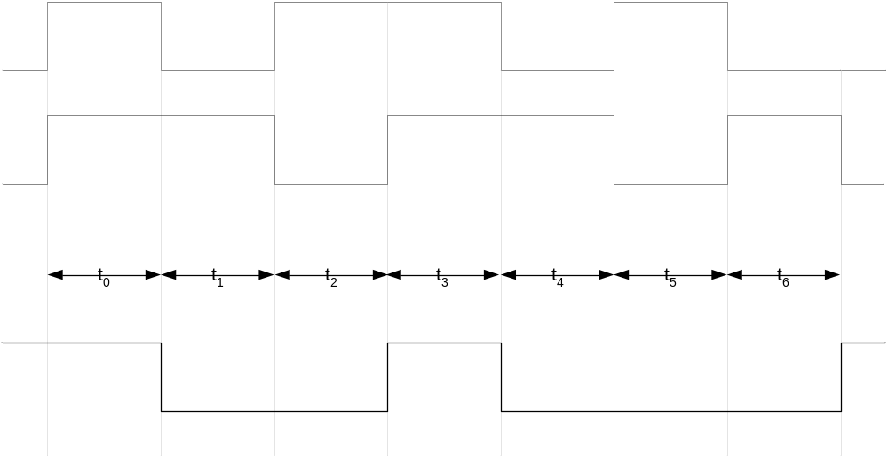
XNOR Gate Timing Diagram

Slide 13
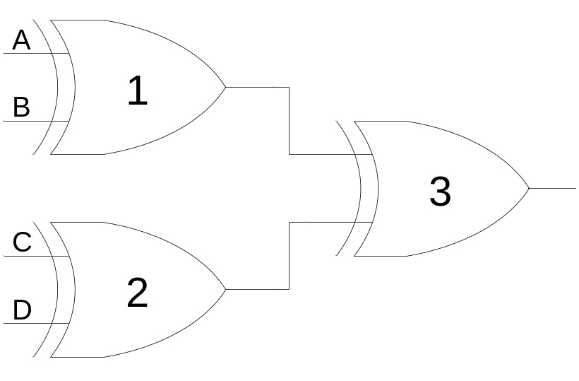
XOR Gate Applications
Detecting odd number of 1’s
Notes:
Consider the three XOR gate logic circuit which is used to detect odd number of 1’s in a 4-bit binary input combination
Consider the 4-bit binary number 0000 applied at the inputs A, B, C and D respectively of XOR gates 1 and 2.
The output of XOR Gates 1 and 2 is 0 and 0. The output of XOR gate 3 is also zero.
Consider the binary number 0011 applied at the inputs A, B, C and D respectively. The output of XOR gate 1 with inputs 00 is 0. The output of XOR gate 2 with inputs 11 is 0. The output of gate 3 is 0. Thus the output indicates that the binary number 0011 does not have odd number of 1’s
Consider the binary number 1011 applied at the inputs A, B, C and D respectively. The output of XOR gate 1 with inputs 10 is 1. The output of XOR gate 2 with inputs 11 is 0. The output of gate 3 is 1. Thus the output indicates that the binary number 1011 has odd number of 1’s

Slide 14

XNOR Gate Applications
Detecting even number of 1’s
Notes:
Consider the two XOR and a single XNOR gate based logic circuit used to detect even number of 1’s in a 4-bit binary input combination
Consider the 4-bit binary number 0000 applied at the inputs A, B, C and D respectively of XOR gates 1 and 2.
The output of XOR Gates 1 and 2 is 0 and 0. The output of XNOR gate 3 is a 1.
Consider the binary number 0011 applied at the inputs A, B, C and D respectively. The output of XOR gate 1 with inputs 00 is 1. The output of XOR gate 2 with inputs 11 is 1. The output of XNOR gate 3 is also a 1. Thus the output indicates that the binary number 0011 has even number of 1’s
Consider the binary number 1011 applied at the inputs A, B, C and D respectively. The output of XOR gate 1 with inputs 10 is 1. The output of XOR gate 2 with inputs 11 is 0. The output of XNOR gate 3 is 0 because of dissimilar inputs. Thus the output indicates that the binary number 1011 does not have even number of 1’s

Slide 15
TTL/CMOS NOT Gate
+V
+V
CC
P-Type
DD
MOSFET
V
V
V
o/p
o/p
i
/
p
+V
V
NPN
i
/
p
Transistor
N-Type
MOSFET
Notes:
The TTL and CMOS implementation of the NOT gate is described.
In the simplified TTL implementation of the NOT gate a transistor switches between logic 1 state and logic 0 state.
When a voltage +V representing logic 1 is applied at the base of the transistor, the transistor is switched on connecting the voltage supply Vcc and the resistor to the ground.
A current flows from the supply to the ground due to which there is a voltage drop equal to the supply voltage Vcc across the resistor.
As a result the output Vo/p is at ground potential or 0 volts which is logic 0. Thus the output of the Transistor circuit is complement of the input.
If the input base of the transistor is connect to 0 volts (logic 0), the transistor is switched off and there is no flow of current from the supply voltage Vcc to the ground through the resistor.
Thus the output of the circuit is at a potential equal to the supply voltage Vcc or logic 1.
The CMOS implementation uses two complementary P-type and N-type MOSFETs or Metal Oxide Field Effect Transistors are used.
When a logic 1 is applied at the Vi/p of the NOT circuit. The P-type MOSFET switches OFF disconnecting the supply voltage Vdd from the output of the NOT circuit. The N-Type MOSFET switches ON, connecting the ground to the output of the NOT circuit. Thus the output of the NOT circuit is at logic 0.
Similarly when a logic 0 is applied at the Vi/p of the NOT circuit. The P-type MOSFET switches ON connecting the supply voltage Vdd to the output of the NOT circuit. The N-Type MOSFET switches OFF, disconnecting the ground from the output of the NOT circuit. Thus the output of the NOT circuit is at logic 1.

Slide 16
Type of IC Logic Gates
74XX00 Quad 2-input NAND Gate
74XX02 Quad 2-input NOR Gate
74XX04 Hex Inverter
74XX08 Quad 2-input AND Gate
74XX10 Triple 3-input NAND Gate
74XX11 Triple 3-input AND Gate
74XX20 Dual 4-input NAND Gate
Notes:
To identify and use the Integrated Circuits or ICs in implementing logic circuits, some sort of identification code has to be used which is printed on the IC package.
Thus the various Logic Gates are identified by the codes shown.
The prefix 74 is used to identify a commercial version of the device from the military version device identified by the prefix 54.
Military versions are designed to withstand harsh and severe environmental conditions.
The XX part of the code identifies the switching speed of the gate.

Slide 17
Type of IC Logic Gates
74XX21 Dual 2-input AND Gate
74XX27 Triple 3-input NOR Gate
74XX30 Single 8-input NAND Gate
74XX32 Quad 2-input OR Gate
74XX86 Quad 2-input XOR Gate
74XX133 Single 13-input NAND Gate

Slide 18
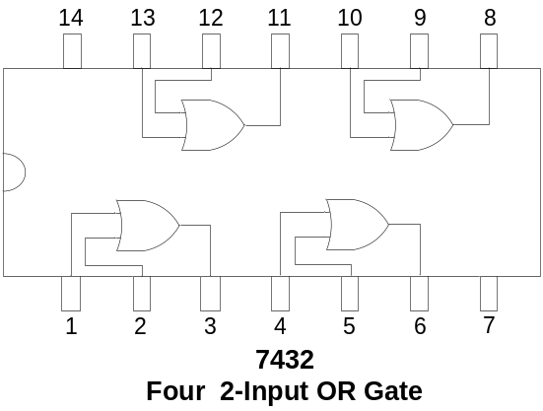
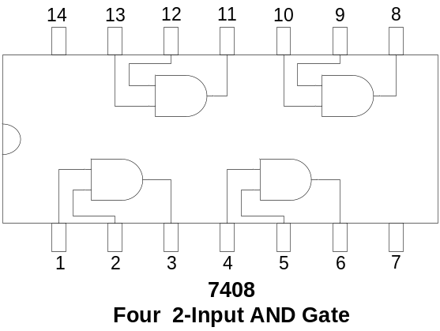
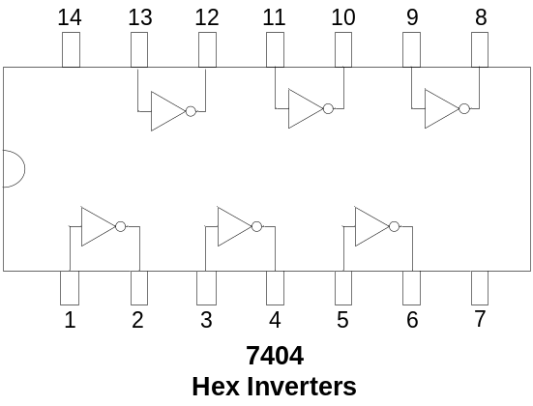
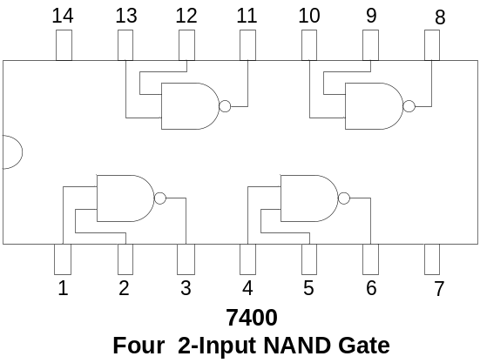
Logic Gate Integrated Circuits
Notes:
The Integrated Circuit packages of the seven gates that have been discussed so far are shown.
The 7408 14-pin chip has 4 or Quad, 2-input AND gates. The input pins and the output pins of each of the four gates are shown. To use any one or all four gates the appropriate pins are connected.
Pins 7 and 14 are connected to ground and Supply voltage respectively.
The 7432 14-pin IC package has 4 or Quad, 2-input OR Gates. Connections to the OR gates are identical to those of the 7408 AND gate IC.
The 7404 14-pin chip has 6 or hex, inverters. The input and output connections of each of the 6 NOT gates are shown. Pins 7 and 14 are used for ground and supply voltage respectively.

Slide 19


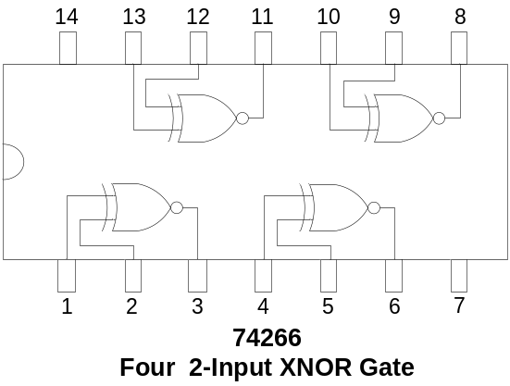
Logic Gate Integrated Circuits
Notes:
The 7400, Quad, 2-input NAND Gate IC
The 7402, Quad, 2-input NOR Gate IC
The 7486, Quad, 2-input XOR Gate IC
And the 74266, Quad, 2-input XNOR Gate IC are similar.

Slide 20
Integrated Circuits (IC)
CMOS Complementary Metal Oxide Logic
TTL Transistor-Transistor Logic
ECL Emitter Coupled Logic
PMOS p-channel MOS transistor
NMOS n-channel MOS transistor
E²CMOS
Notes:
CMOS: The most extensively used technology, characterized by low power consumption, switching speed which is slower but comparable to TTL. Has higher chip density than TTL. Due to high input impedance is easily damaged due to accumulated static charge
TTL: Extensively used technology, characterized by fast switching speed and high power consumption
ECL: Used in specialized applications where switching speed is of prime importance, high speed transmission, memories and arithmetic units
PMOS and NMOS: technologies are used in LSI requiring high chip density. Large memories and microprocessors are implemented using these technologies. These ICs have very low power consumption.
E²CMOS: a combination of CMOS and NMOS technologies used to implement Programmable Logic Devices.

Slide 21
Operational Characteristics
DC Supply Voltage
Noise Margin
Power Dissipation
Frequency Response
Fan Out

